Slide 1

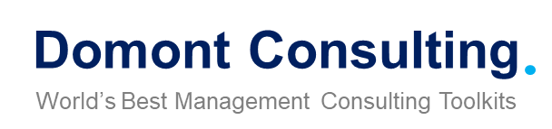
Confidential
Supply Chain Strategy Toolkit
Overview

Slide 2


Introduction
This Toolkit was created by ex-McKinsey, Deloitte and BCG Management Consultants specialized in Supply Chain Management, after more than 5,000 hours of work. It is considered the world's best & most comprehensive Supply Chain Strategy Toolkit. It includes all the Frameworks, Best Practices & Templates required to improve your skills and the supply chain capability of your organization.
Join the 200,000+ Executives, Consultants & Entrepreneurs who are already leveraging our Management Consulting Toolkits to improve the performance of their organization and boost their own career.
If you have any questions, send us an email at support@domontconsulting.com and one of our ex-McKinsey, Deloitte & BCG Management Consultants will get back to you within 2 business days.
Aurelien Domont
Management Consultant
Domont Consulting Managing Director

Slide 3

Success stories of companies that gained a competitive advantage through supply chain improvement (1/3)
One successful company that gained a competitive advantage through supply chain improvement is Walmart. In the early 2000s, Walmart was facing stiff competition from other retailers and needed to find a way to reduce costs and improve efficiency. The company realized that its supply chain was a key area where it could make improvements.
Walmart made several changes to its supply chain, including implementing a vendor-managed inventory system and using cross-docking to reduce the amount of time products spent in the supply chain. These changes allowed Walmart to reduce inventory levels and increase the speed at which products were moved through the supply chain.
As a result, Walmart was able to offer lower prices to customers, which helped the company gain a competitive advantage over other retailers. The improved supply chain also allowed Walmart to better manage its inventory levels and reduce waste, leading to further cost savings.
Today, Walmart is one of the world's largest retailers, with a supply chain that is widely regarded as one of the most efficient in the industry. By focusing on supply chain improvements, Walmart was able to gain a significant competitive advantage and become a dominant player in the retail industry.

Slide 4

Success stories of companies that gained a competitive advantage through supply chain improvement (2/3)
Another example of a company that gained a competitive advantage through supply chain improvements is Zara, a Spanish clothing retailer. Zara realized early on that its supply chain was a key factor in its success and invested heavily in developing a fast and efficient supply chain.
Zara uses a "fast fashion" model that allows the company to quickly respond to changes in consumer demand and bring new products to market within weeks. This is achieved through a highly integrated supply chain that includes in-house design, production, and distribution.
One key aspect of Zara's supply chain is its vertical integration. The company owns much of its production capacity, which allows it to be more flexible and responsive to changes in demand. Zara also uses technology to monitor sales and trends in real-time, allowing the company to quickly adjust production levels and shift resources to where they are needed most.
As a result of these supply chain improvements, Zara has been able to achieve a competitive advantage over other clothing retailers. The company is able to bring new products to market faster than its competitors, and its highly efficient supply chain allows it to keep costs low while maintaining high levels of quality.

Slide 5
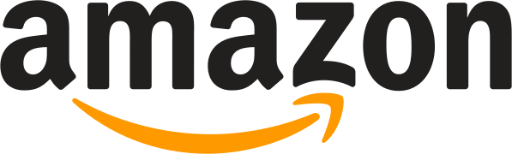
Success stories of companies that gained a competitive advantage through supply chain improvement (3/3)
Another example of a company that gained a competitive advantage through supply chain improvements is Amazon. The e-commerce giant has built one of the most sophisticated and efficient supply chains in the world, allowing it to offer fast and reliable delivery to customers around the globe.
Amazon's supply chain is built on a network of warehouses and distribution centers, as well as a fleet of delivery vehicles and a sophisticated logistics system. The company has invested heavily in technology to optimize its supply chain, using algorithms and machine learning to forecast demand and manage inventory levels.
One key aspect of Amazon's supply chain is its use of fulfillment centers. These centers are strategically located near major population centers and allow Amazon to offer same-day and next-day delivery to many customers. The company also offers a variety of delivery options, including delivery to lockers and pickup points, which further enhances its ability to serve customers quickly and efficiently.
As a result of these supply chain improvements, Amazon has been able to gain a significant competitive advantage in the e-commerce industry. The company is able to offer fast and reliable delivery, which is a major factor in customer satisfaction and loyalty. Additionally, Amazon's efficient supply chain allows it to keep costs low, which helps the company remain competitive on price.

Slide 6











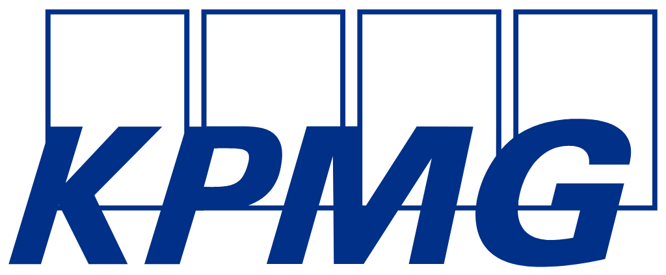
Our firm created a Supply Chain Strategy Toolkit to help you create your own success stories
What’s inside the Toolkit?
Who created the Toolkit?
The Toolkit was created ex-McKinsey, Deloitte and BCG Management Consultants.
Best Practices
Frameworks
Number of professionals leveraging our Toolkits
Advice from
tier-1 Management Consultants
Tools
There are 200,000+ Executives, Consultants & Entrepreneurs leveraging our Toolkits to improve the performance of their organization
Real-life Examples
Templates
Trusted by small and large organizations
Video Training
Step-by-step Tutorials

Slide 7
Our Toolkit will help you fulfill multiple objectives
The Supply Chain Strategy Toolkit includes frameworks, tools, templates, tutorials, real-life examples, video training, and best practices to help you:
Define and implement your Supply Chain Strategy using our world-class 6-phase approach: (I) Supply Chain Overarching Strategy, (II) Four Pillars to reach our Strategic Objectives: Demand & Supply Planning Strategy, Sourcing & Procurement Strategy, Manufacturing Strategy, and Logistics & Distribution Strategy, (III) Potential Initiatives to reach the future state of each Pillar, (IV) Business cases and financial models to assess potential Initiatives, (V) Project Prioritization, Business Roadmap and Implementation, and (VI) Change Management, Internal Communication and Stakeholder Engagement
Define and implement your Supply Chain Overarching Strategy: (1) Summary of the corporate & Business strategy, (2) Supply chain vision, mission and values, (3) Supply chain strategic objectives to reach our vision, (4) Team & budget, (5) Make or buy decision, (6) Kraljic Matrix, (7) Guiding principles and key pillars
Define and implement your Demand & Supply Planning Strategy: (1) Overview and best practices of the function “Demand & Supply Planning”, (2) Maturity model, (3) Key performance indicators (KPIs), (4) Current state and future state of the company
Define and implement your Sourcing & Procurement Strategy: (1) Overview and best practices of the function “Sourcing & Procurement”, (2) Maturity model, (3) Key performance indicators (KPIs), (4) Current state and future state of the company
Define and implement your Manufacturing Strategy: (1) Overview and best practices of the function “Manufacturing”, (2) Maturity model, (3) Key performance indicators (KPIs), (4) Current state and future state of the company
Define and implement your Logistics & Distribution Strategy: (1) Overview and best practices of the function “Logistics & Distribution”, (2) Maturity model, (3) Key performance indicators (KPIs), (4) Current state and future state of the company
List your potential initiatives for each pillar
Create your business cases and financial models to assess potential initiatives
Prioritize, plan and implement your projects: (1) Project prioritization, (2) Business roadmap, (3) Governance, (4) Dashboards, (5) Project implementation: agile methodology, design thinking and traditional methodology, (6) Continuous improvement (7) Post program/projects evaluation and lessons learnt
Define and implement your change management strategy and internal communication strategy: (1) Change management strategy, (2) Change management plans, (3) Implementation, tracking and progress management, (4) Effective communication
Engage your stakeholders effectively: (1) Stakeholder analysis, (2) Stakeholder engagement strategy, (3) Stakeholder engagement detailed plan

Slide 8

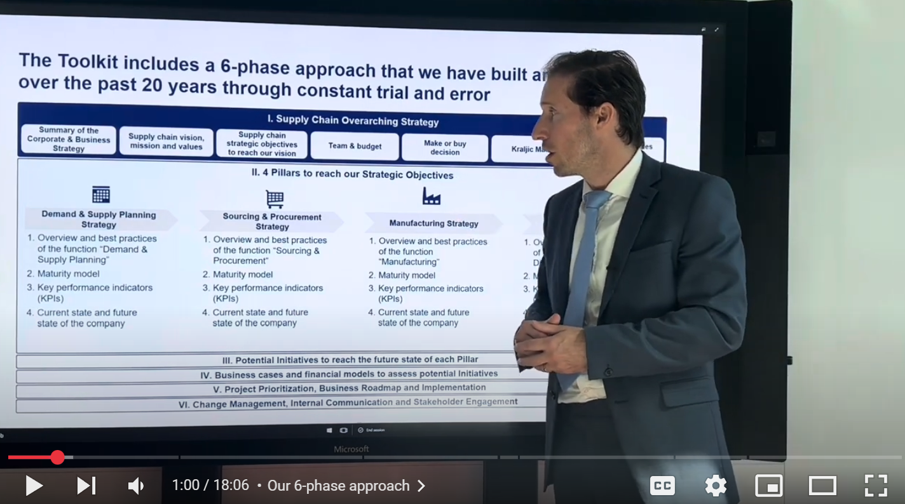
Video demonstration of the Toolkit
Video Demo Access
Video Demo Visual
Select “Slide Show” mode and then click on the link below or on the image on the right to access this video demo.
You can also access the video by copy pasting the following URL in your browser:
https://youtu.be/LKiZqhaHAKk

Slide 9

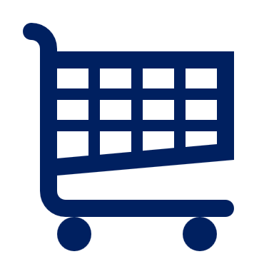

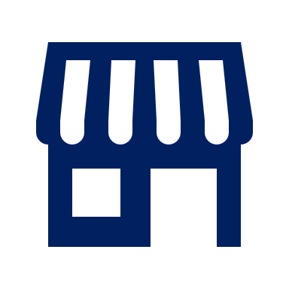
The Toolkit includes a 6-phase approach that we have built and refined over the past 20 years through constant trial and error
I. Supply Chain Overarching Strategy
Summary of the Corporate & Business Strategy
Supply chain vision, mission and values
Supply chain strategic objectives to reach our vision
Team & budget
Make or buy decision
Kraljic Matrix
Guiding principles and key pillars
II. 4 Pillars to reach our Strategic Objectives
Demand & Supply Planning Strategy
Sourcing & Procurement Strategy
Manufacturing Strategy
Logistics & Distribution Strategy
Overview and best practices of the function “Demand & Supply Planning”
Maturity model
Key performance indicators (KPIs)
Current state and future state of the company
Overview and best practices of the function “Sourcing & Procurement”
Maturity model
Key performance indicators (KPIs)
Current state and future state of the company
Overview and best practices of the function “Manufacturing”
Maturity model
Key performance indicators (KPIs)
Current state and future state of the company
Overview and best practices of the function “Logistics & Distribution”
Maturity model
Key performance indicators (KPIs)
Current state and future state of the company
III. Potential Initiatives to reach the future state of each Pillar
IV. Business cases and financial models to assess potential Initiatives
V. Project Prioritization, Business Roadmap and Implementation
VI. Change Management, Internal Communication and Stakeholder Engagement

Slide 10
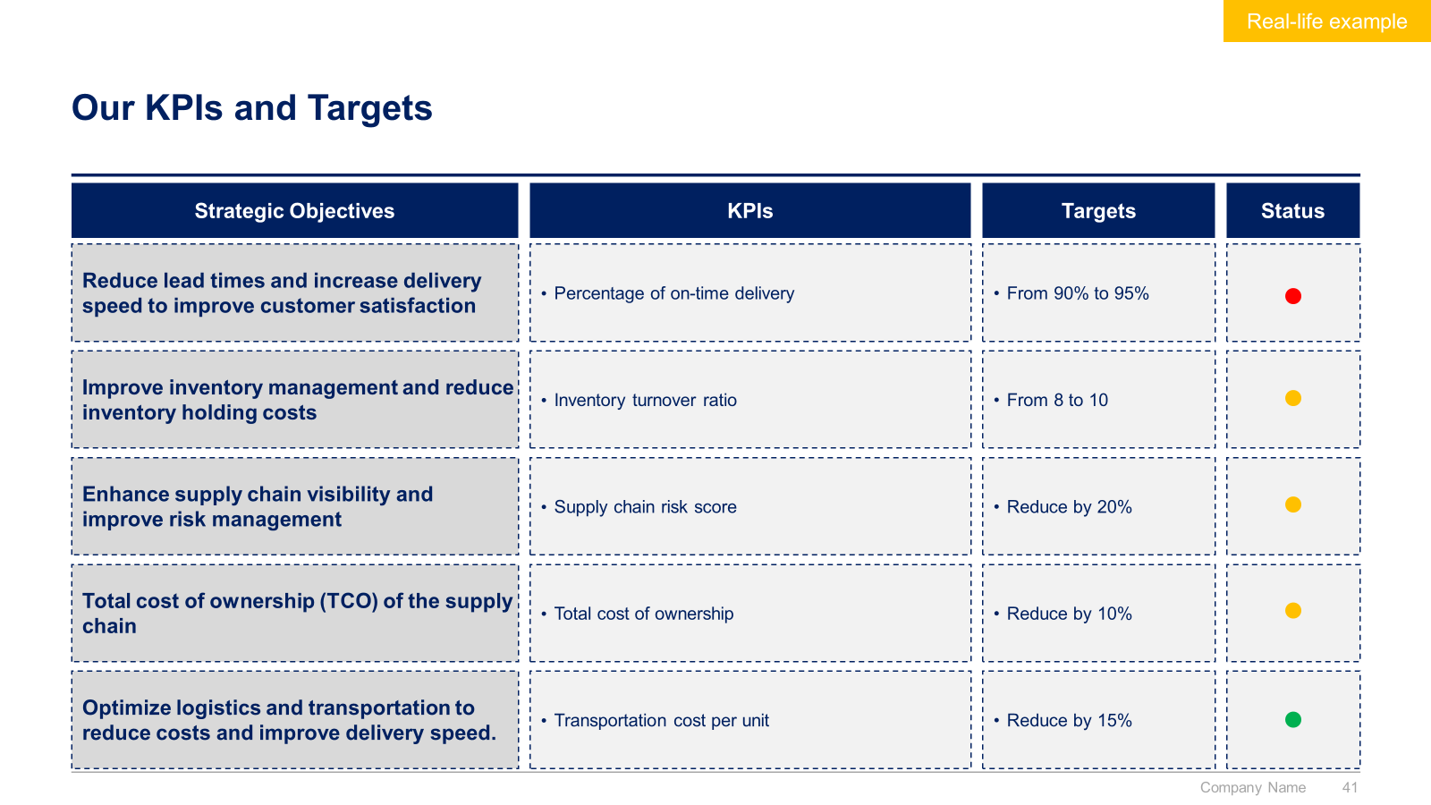
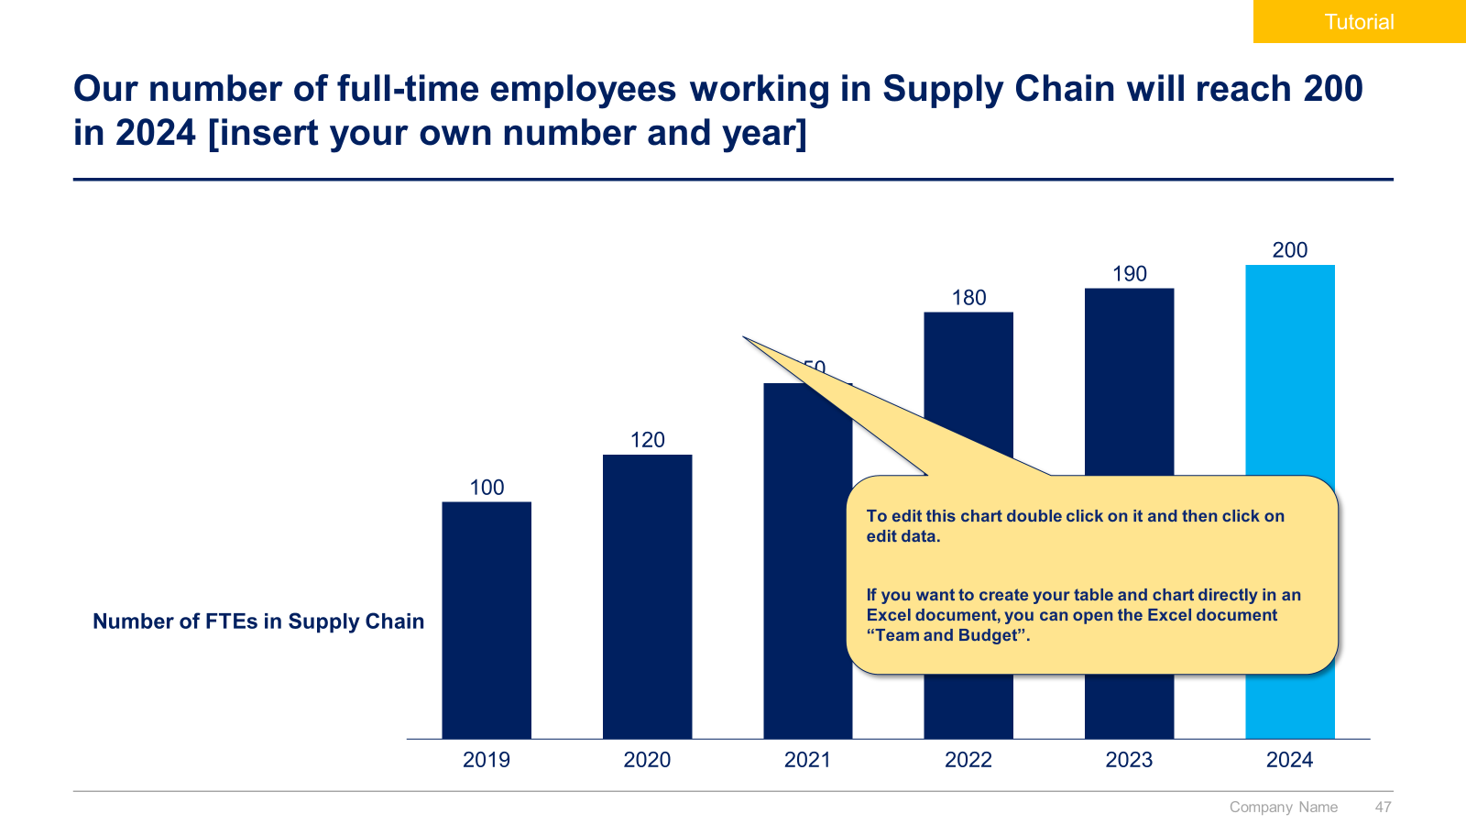
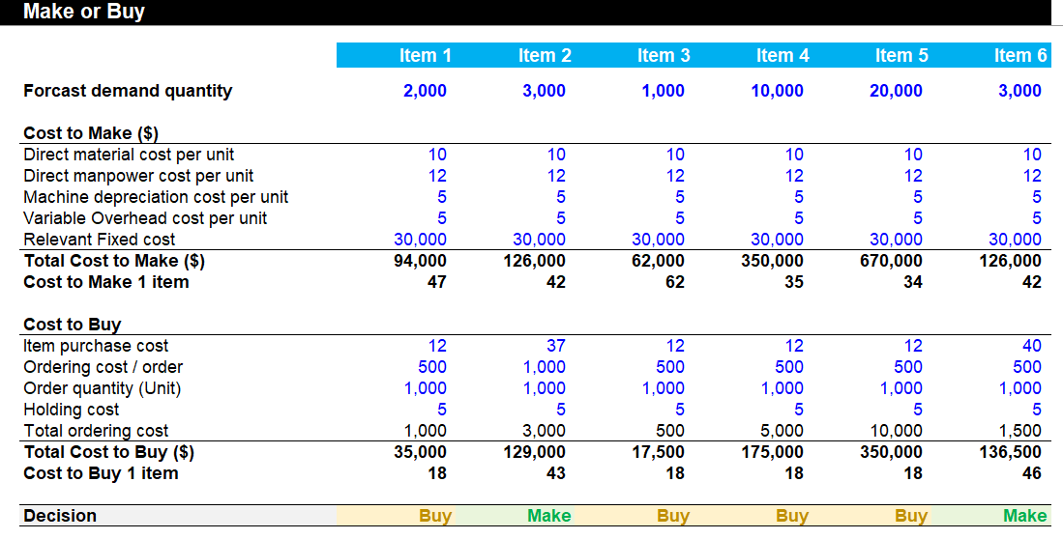
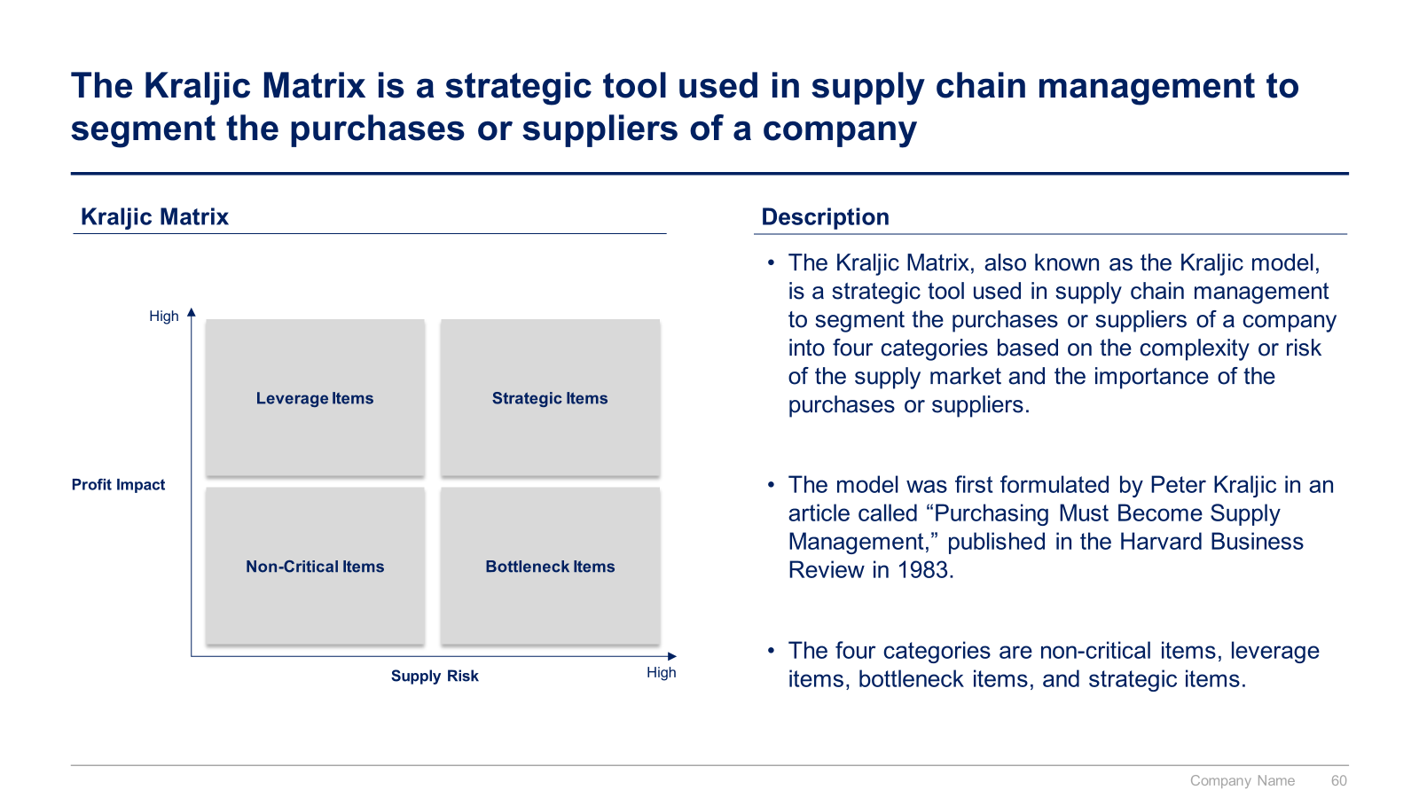
Small preview of the phase I “Supply Chain Overarching Strategy”

Slide 11
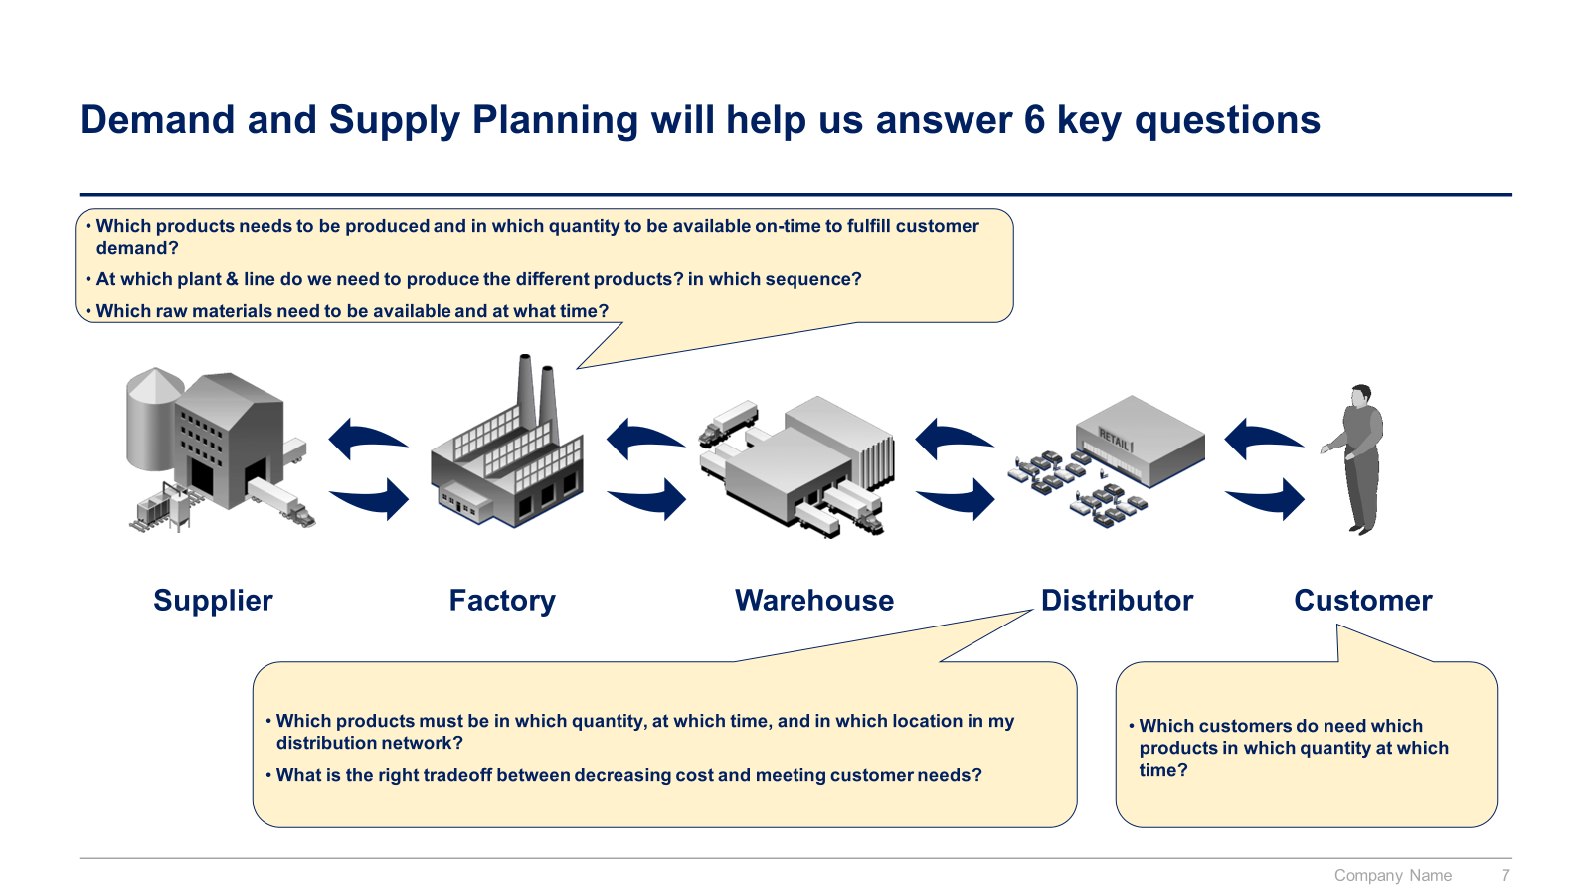
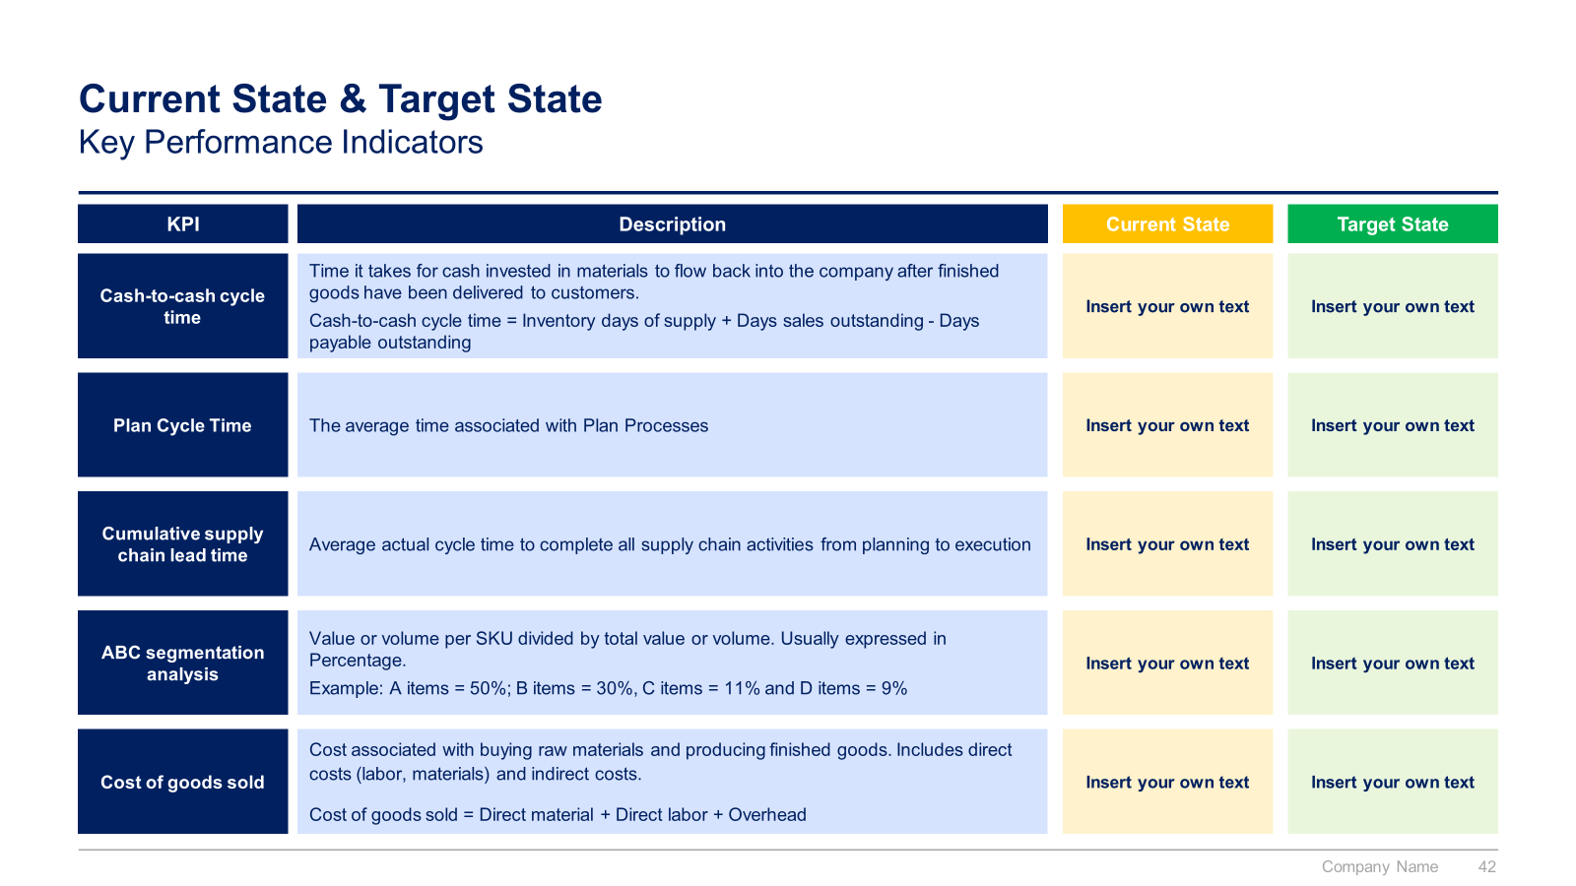
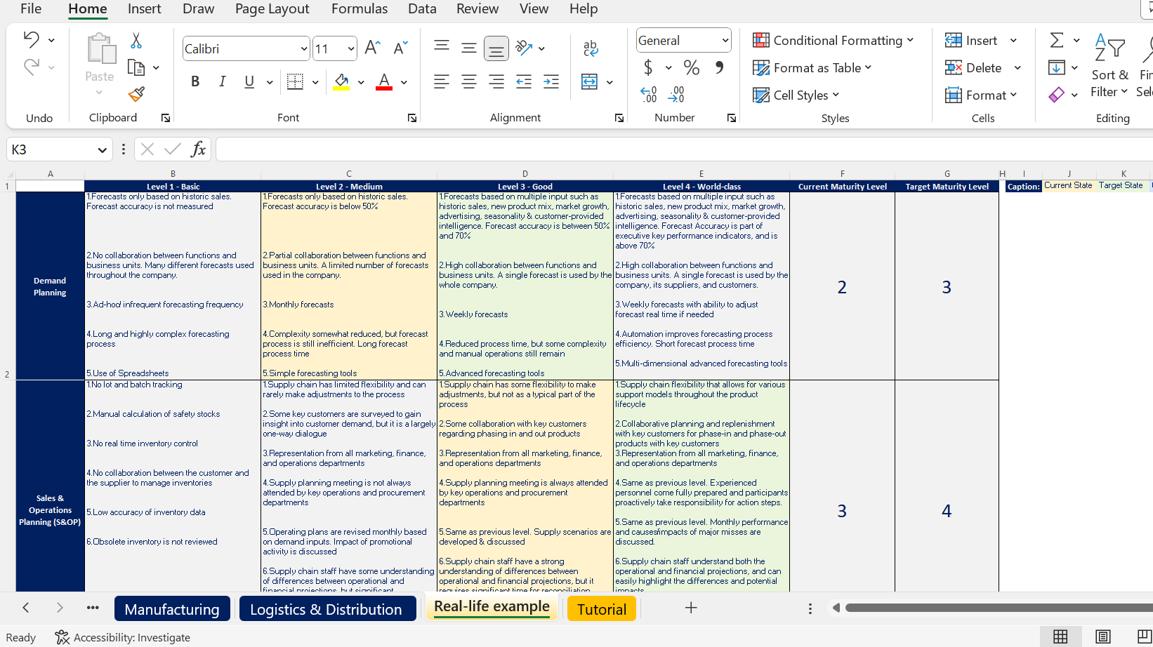
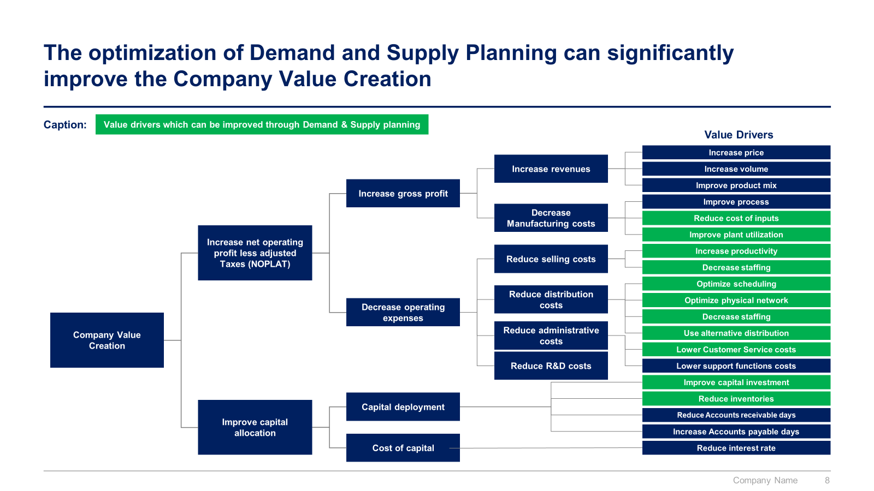
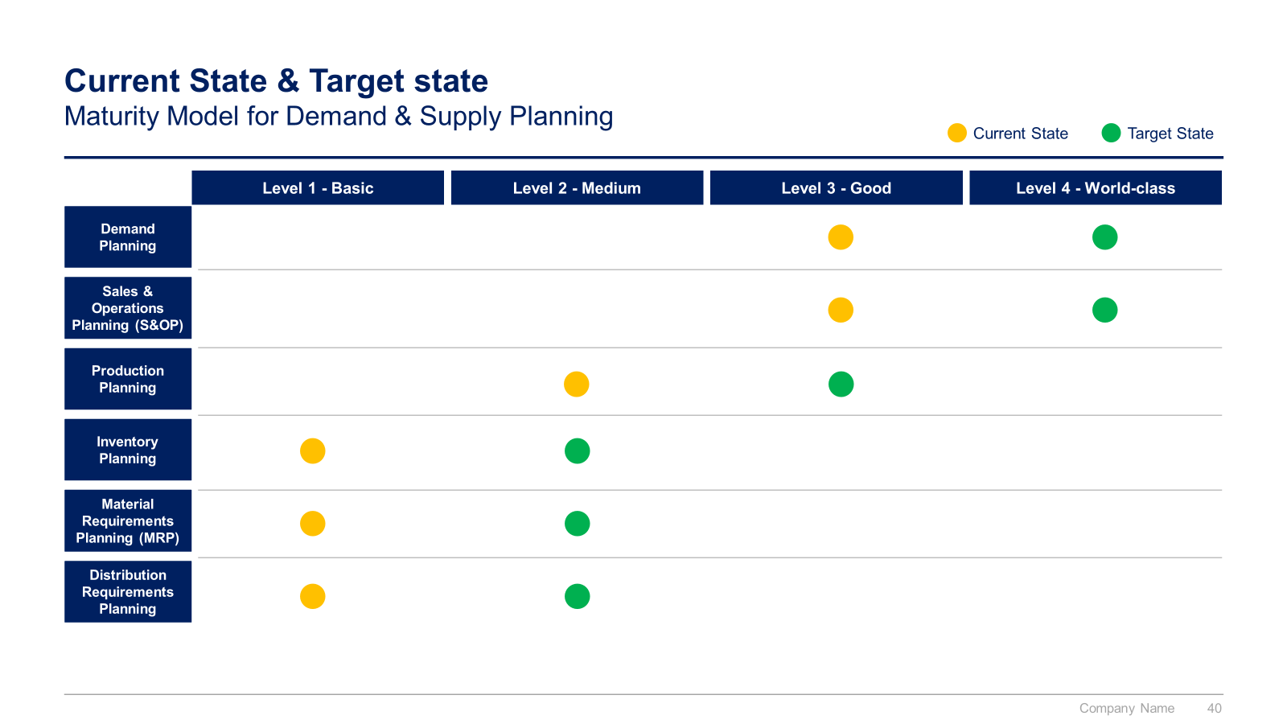
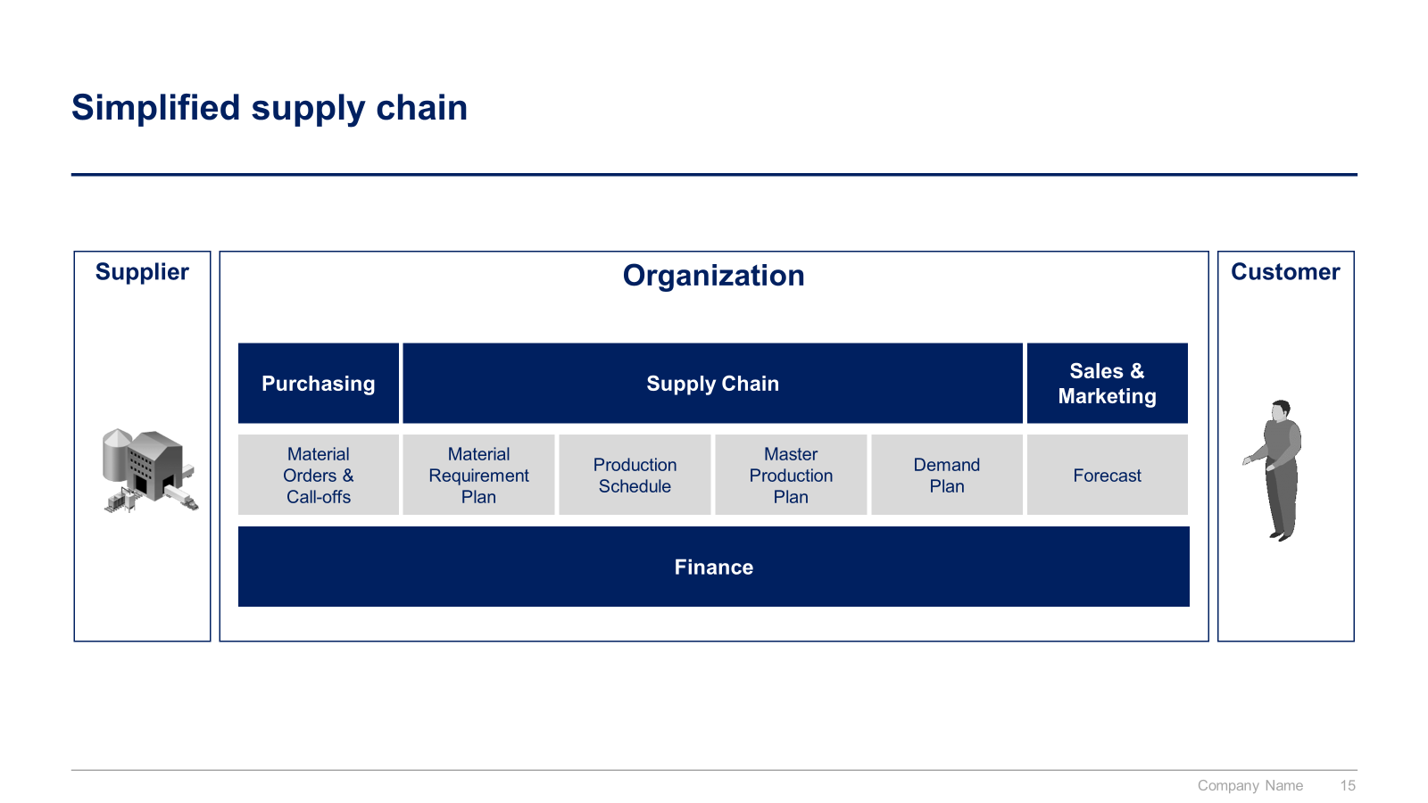
Small preview of the phase II “4 Pillars to reach our Strategic Objectives” (1/2)

Slide 12
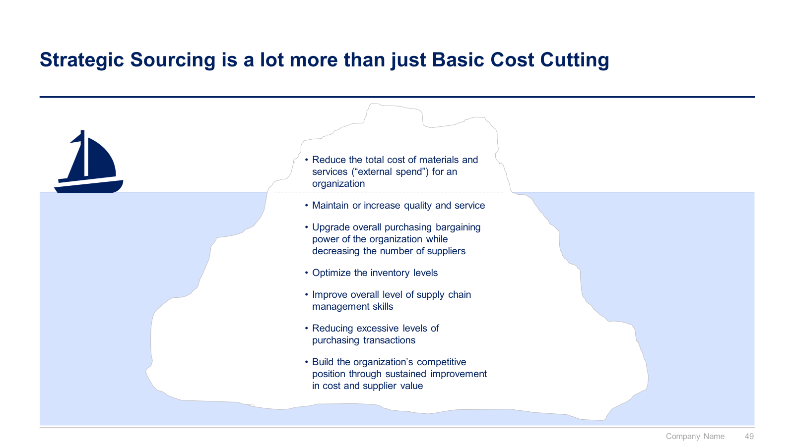
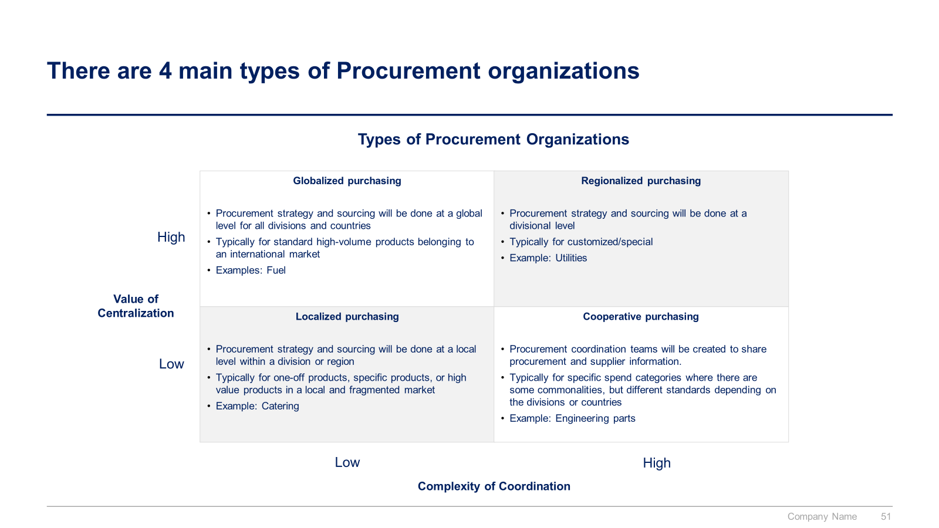
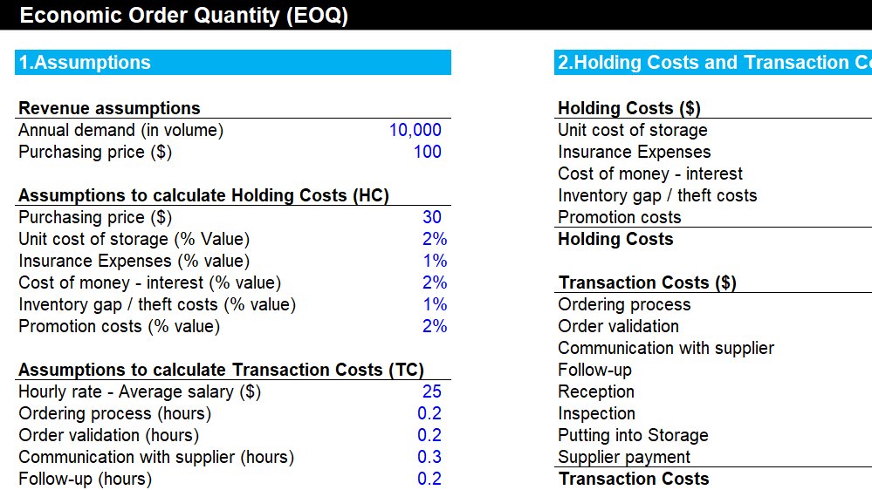
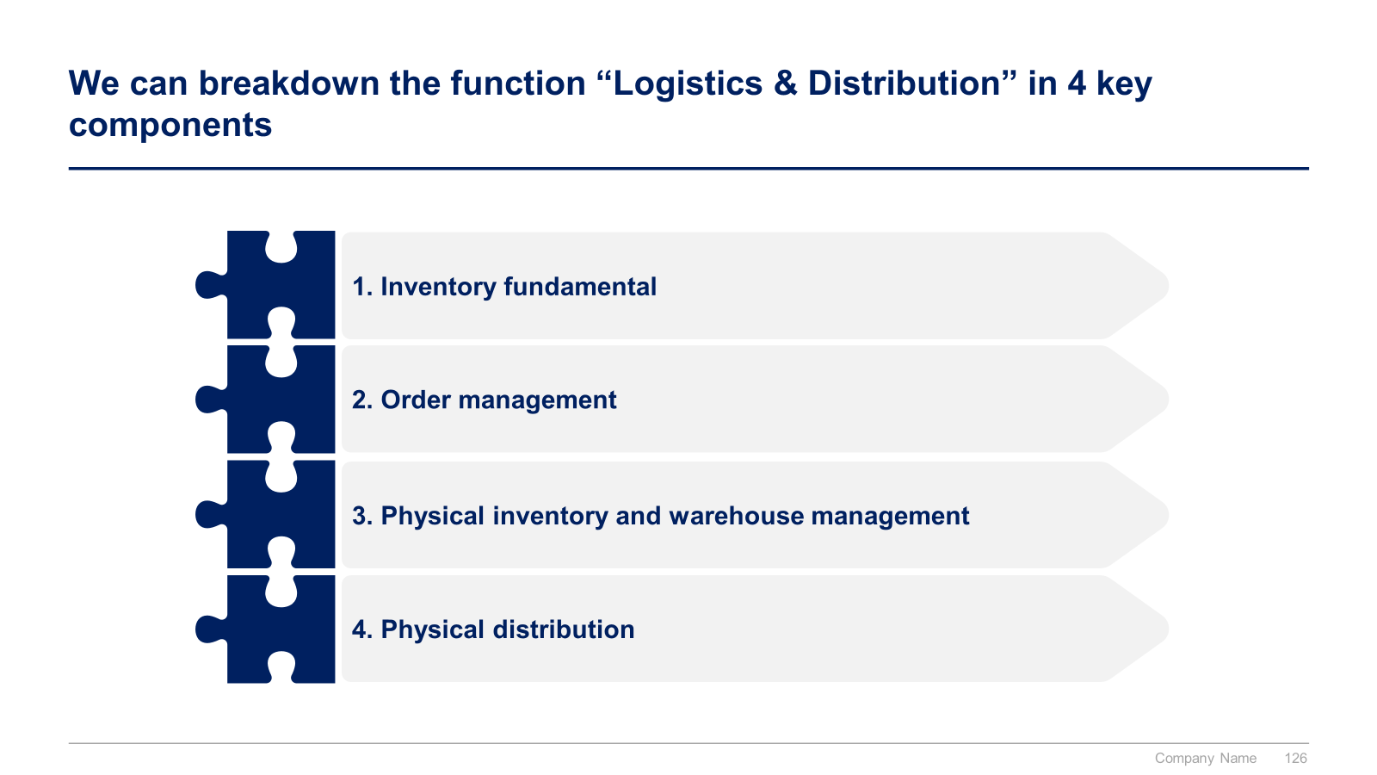
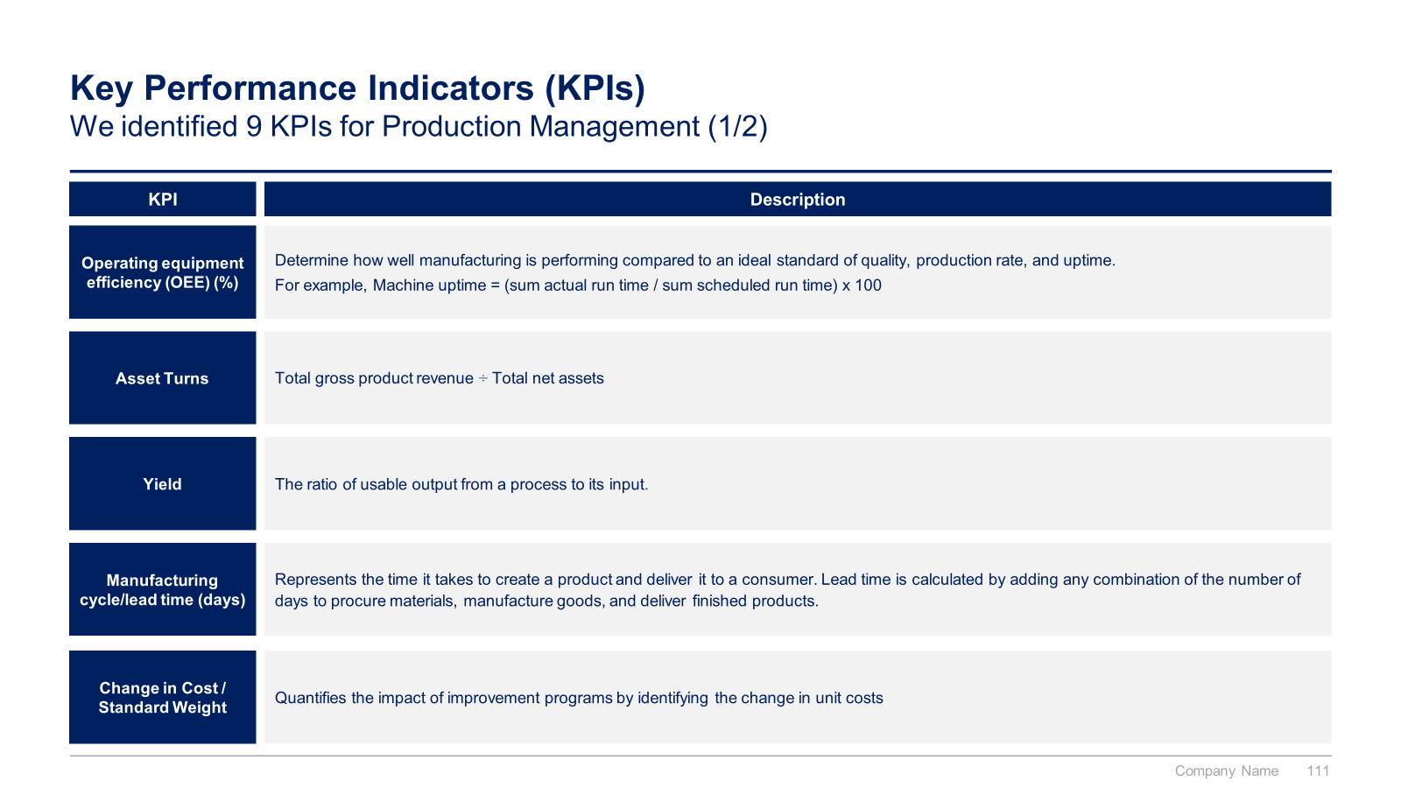
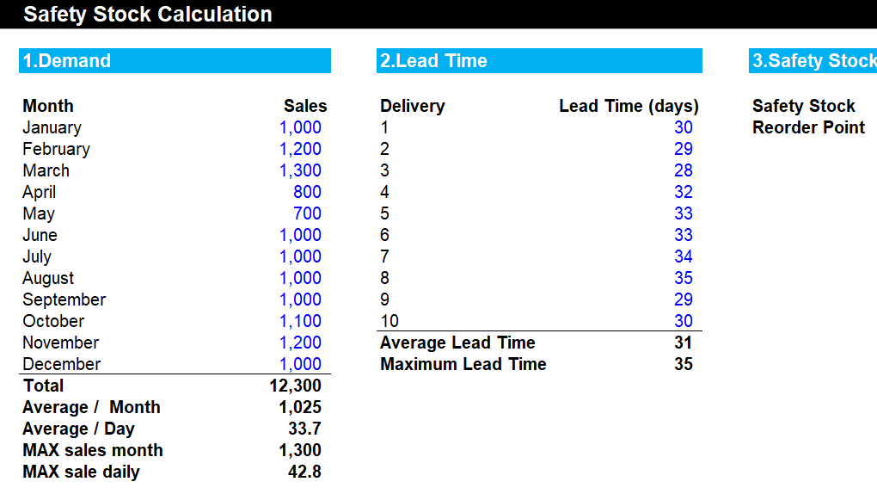
Small preview of the phase II “4 Pillars to reach our Strategic Objectives” (2/2)

Slide 13
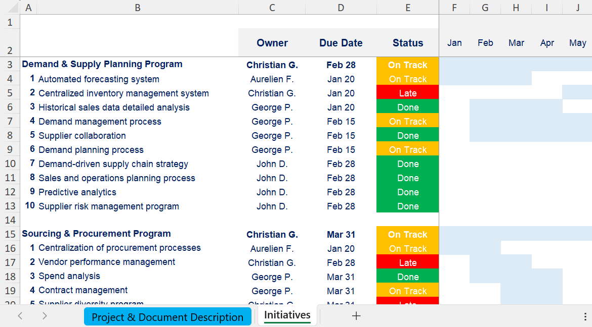
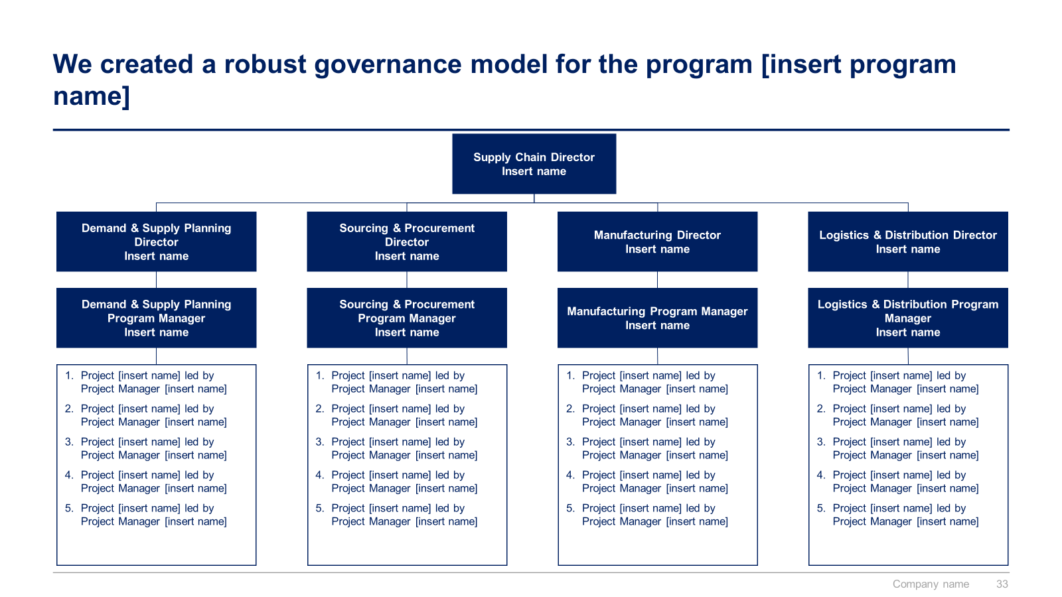
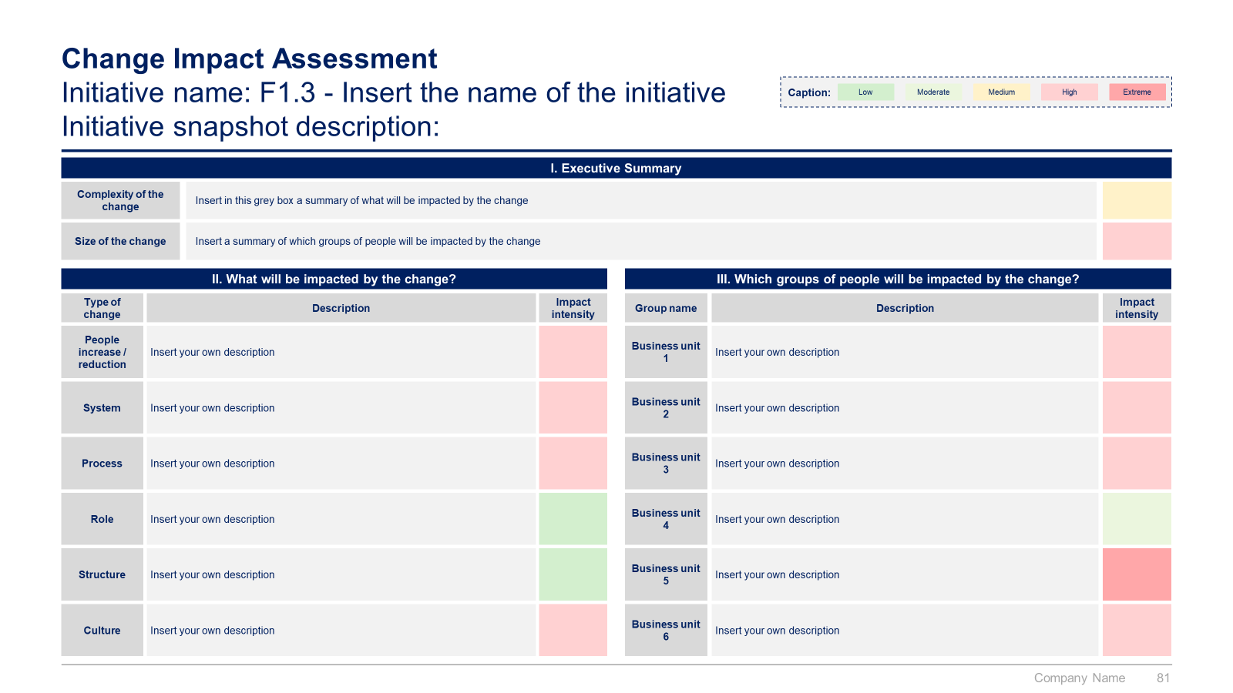
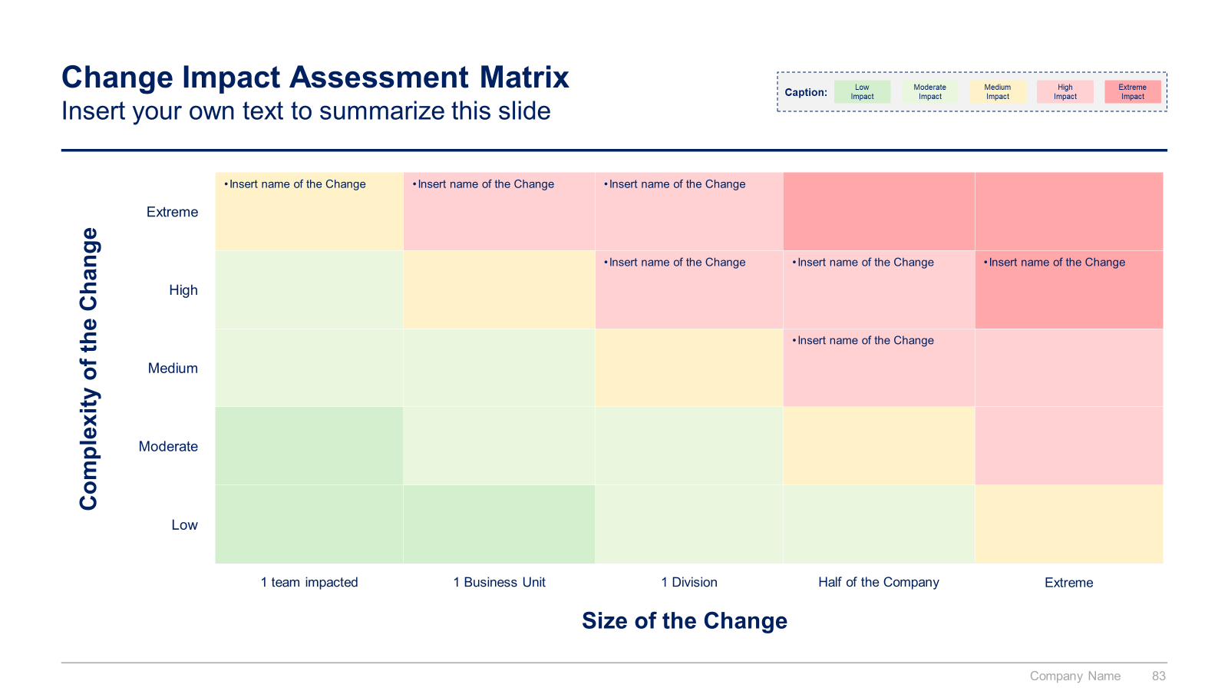
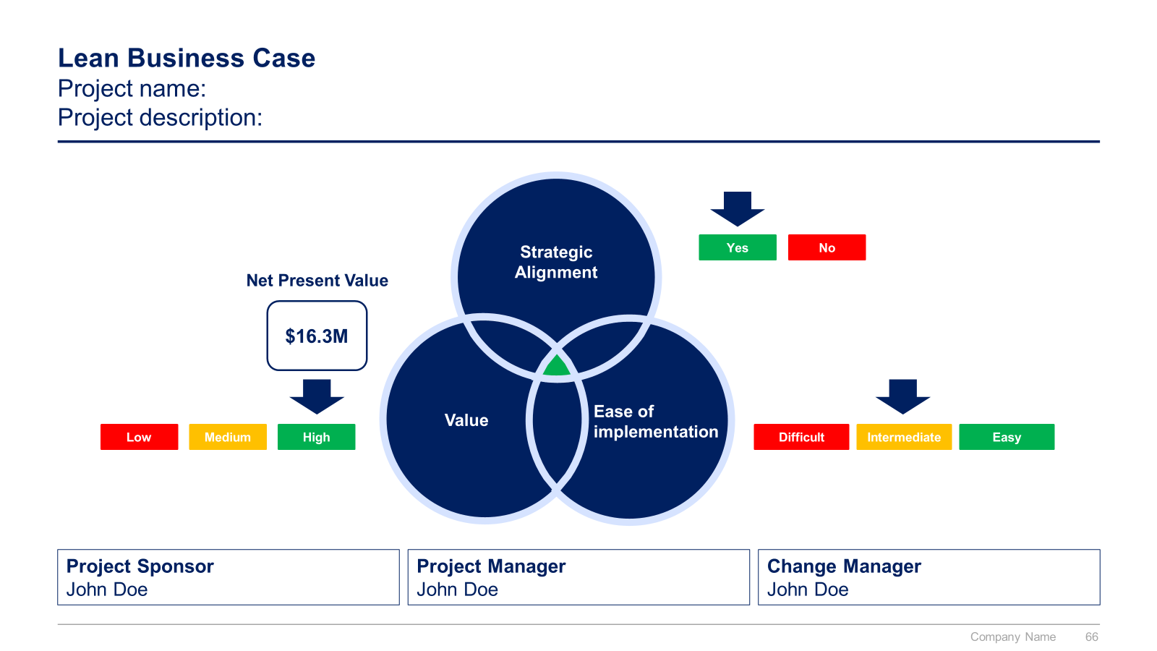
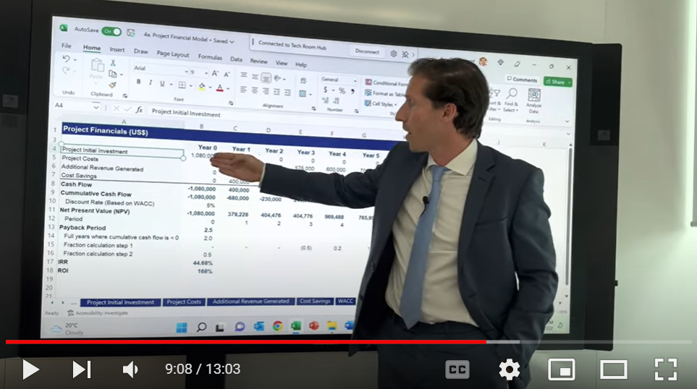
Small preview of the phase III, IV, V and VI

Slide 14
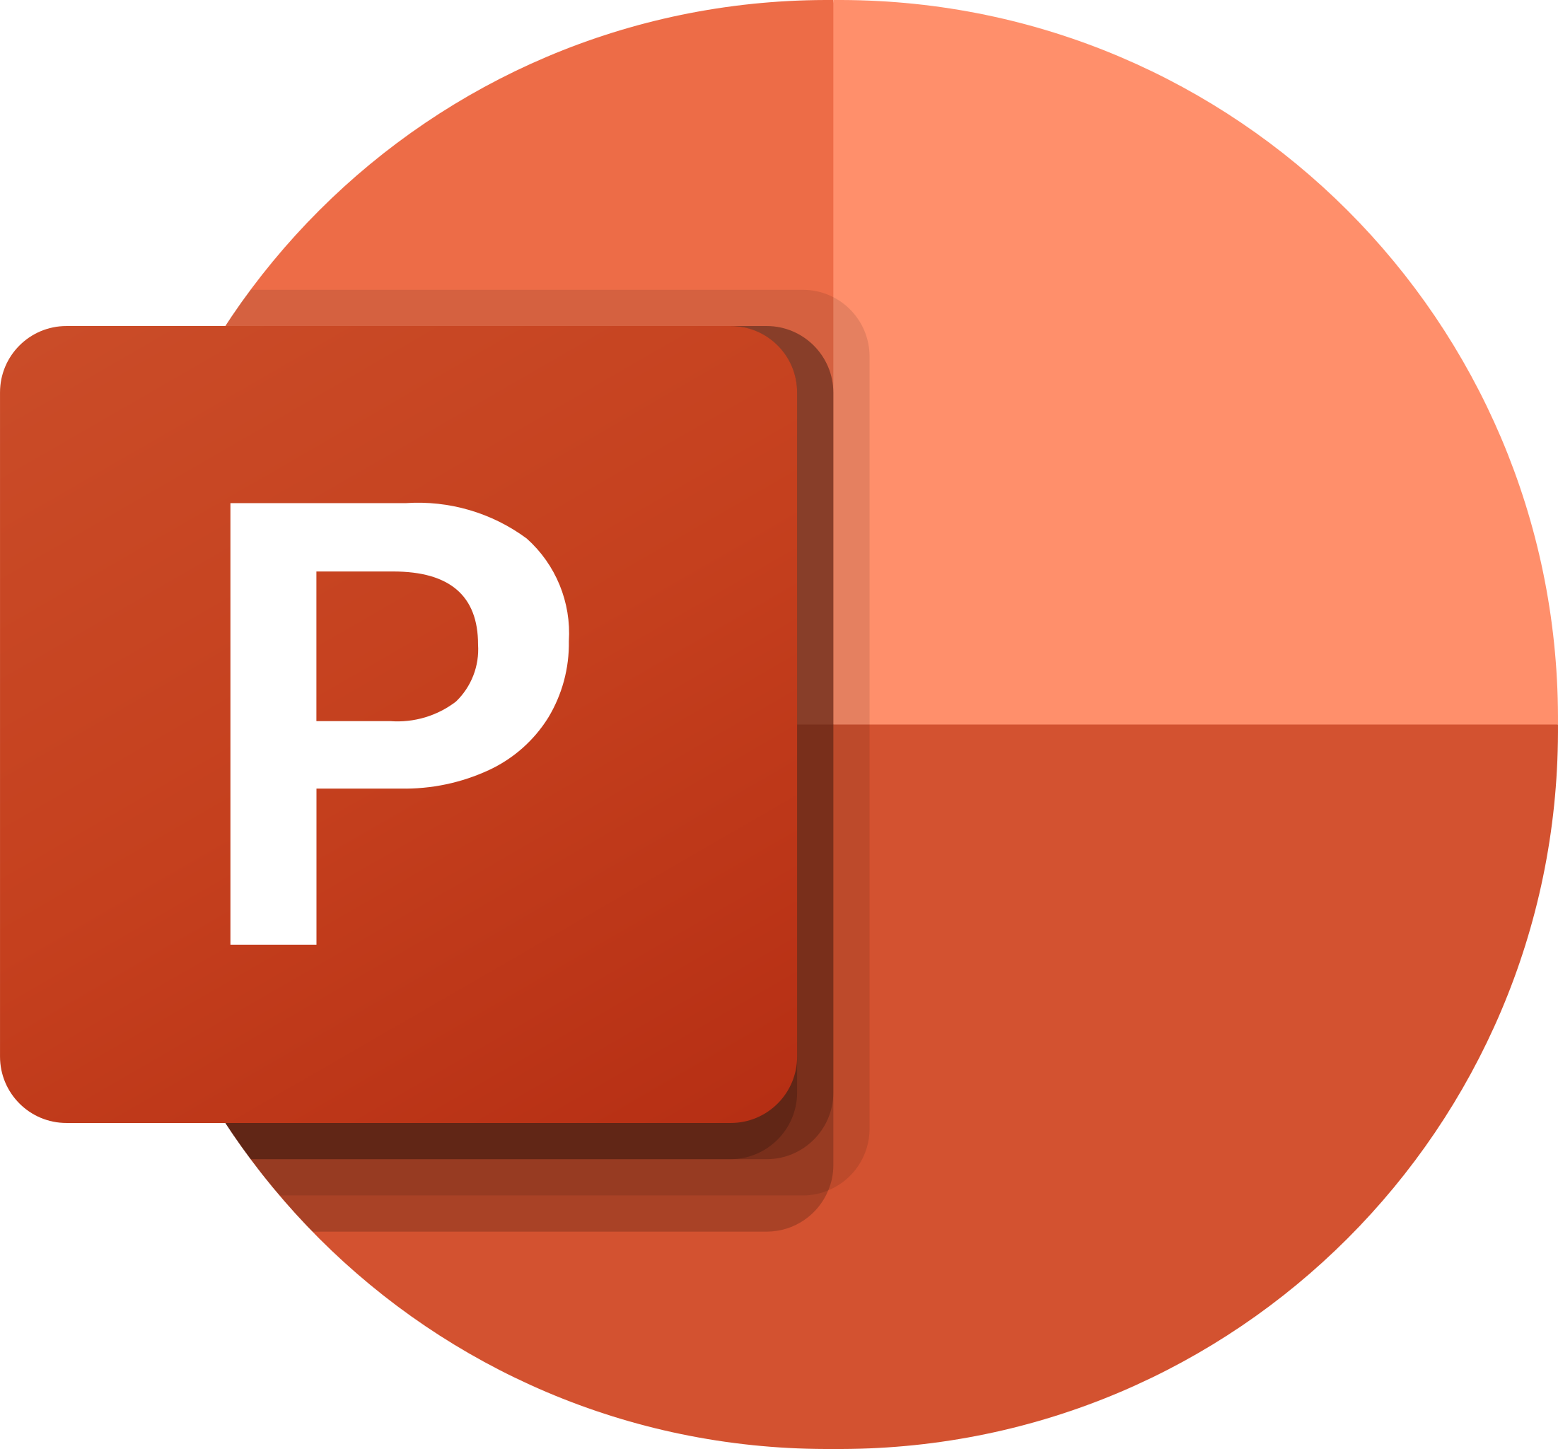
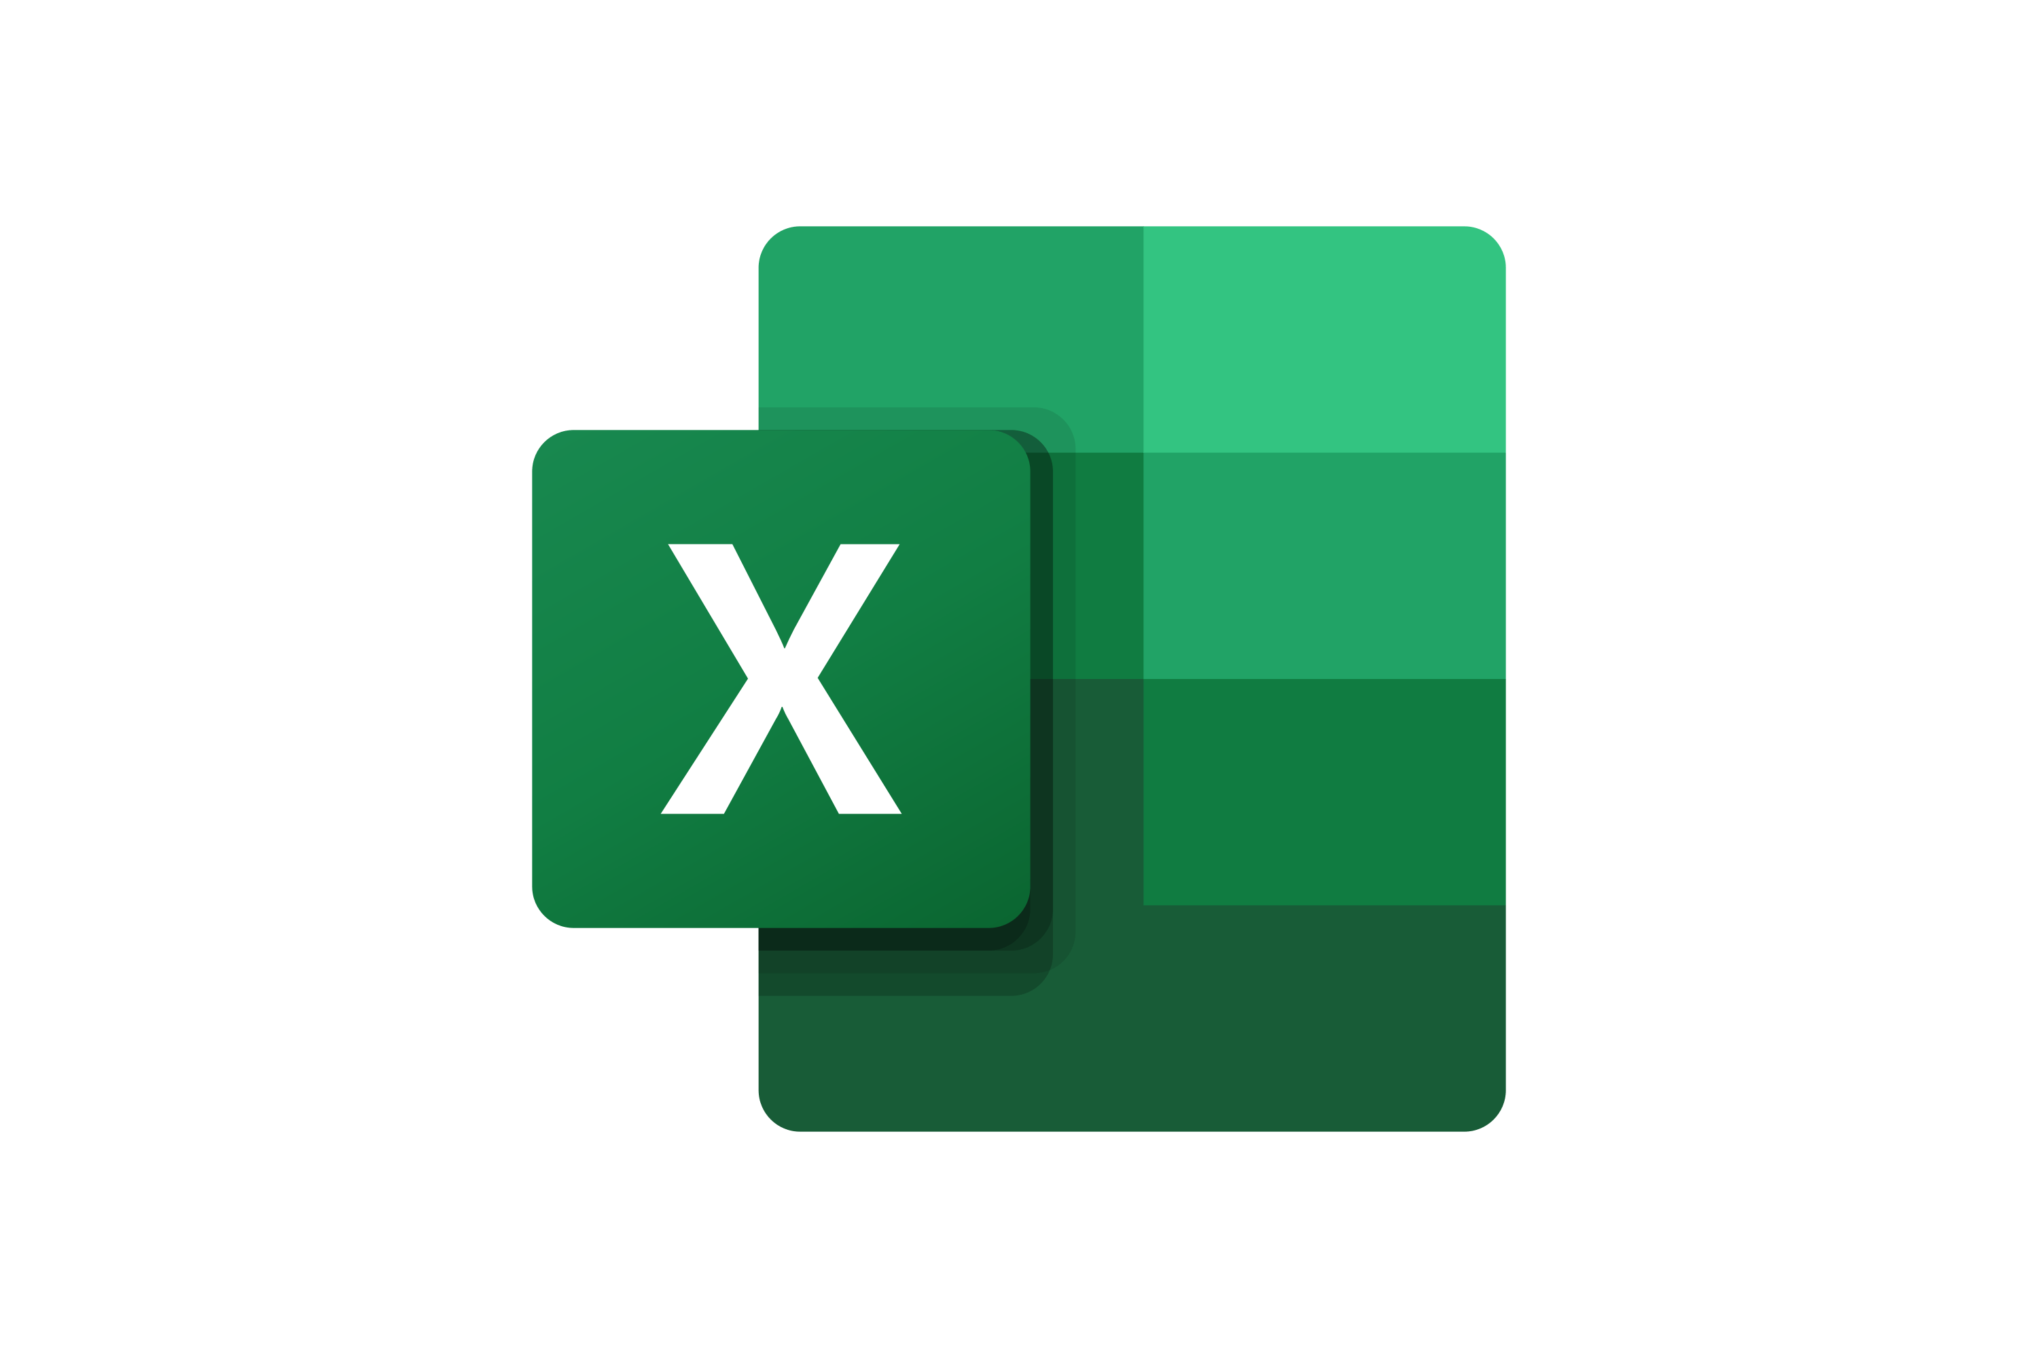

The Toolkit includes multiple PowerPoint slides, Excel sheets and Video training that you can download on your device immediately after purchase
600 editable PowerPoint slides*
23 Excel sheets*
1 hour of Video training
Supply Chain Strategy Toolkit - Overview
Supply Chain Overarching Strategy
Four Pillars to reach our Strategic Objectives
Potential Initiatives
Business Cases and Financial Models
Project Prioritization, Business Roadmap and Implementation
Change Management, Internal Communication and Stakeholder Engagement
*Please note that the number of Powerpoint slides and Excel sheets listed is the number of unique slides and sheets. For example, a Powerpoint slide that has been duplicated to facilitate our clients’ understanding only counts for one slide

Slide 15
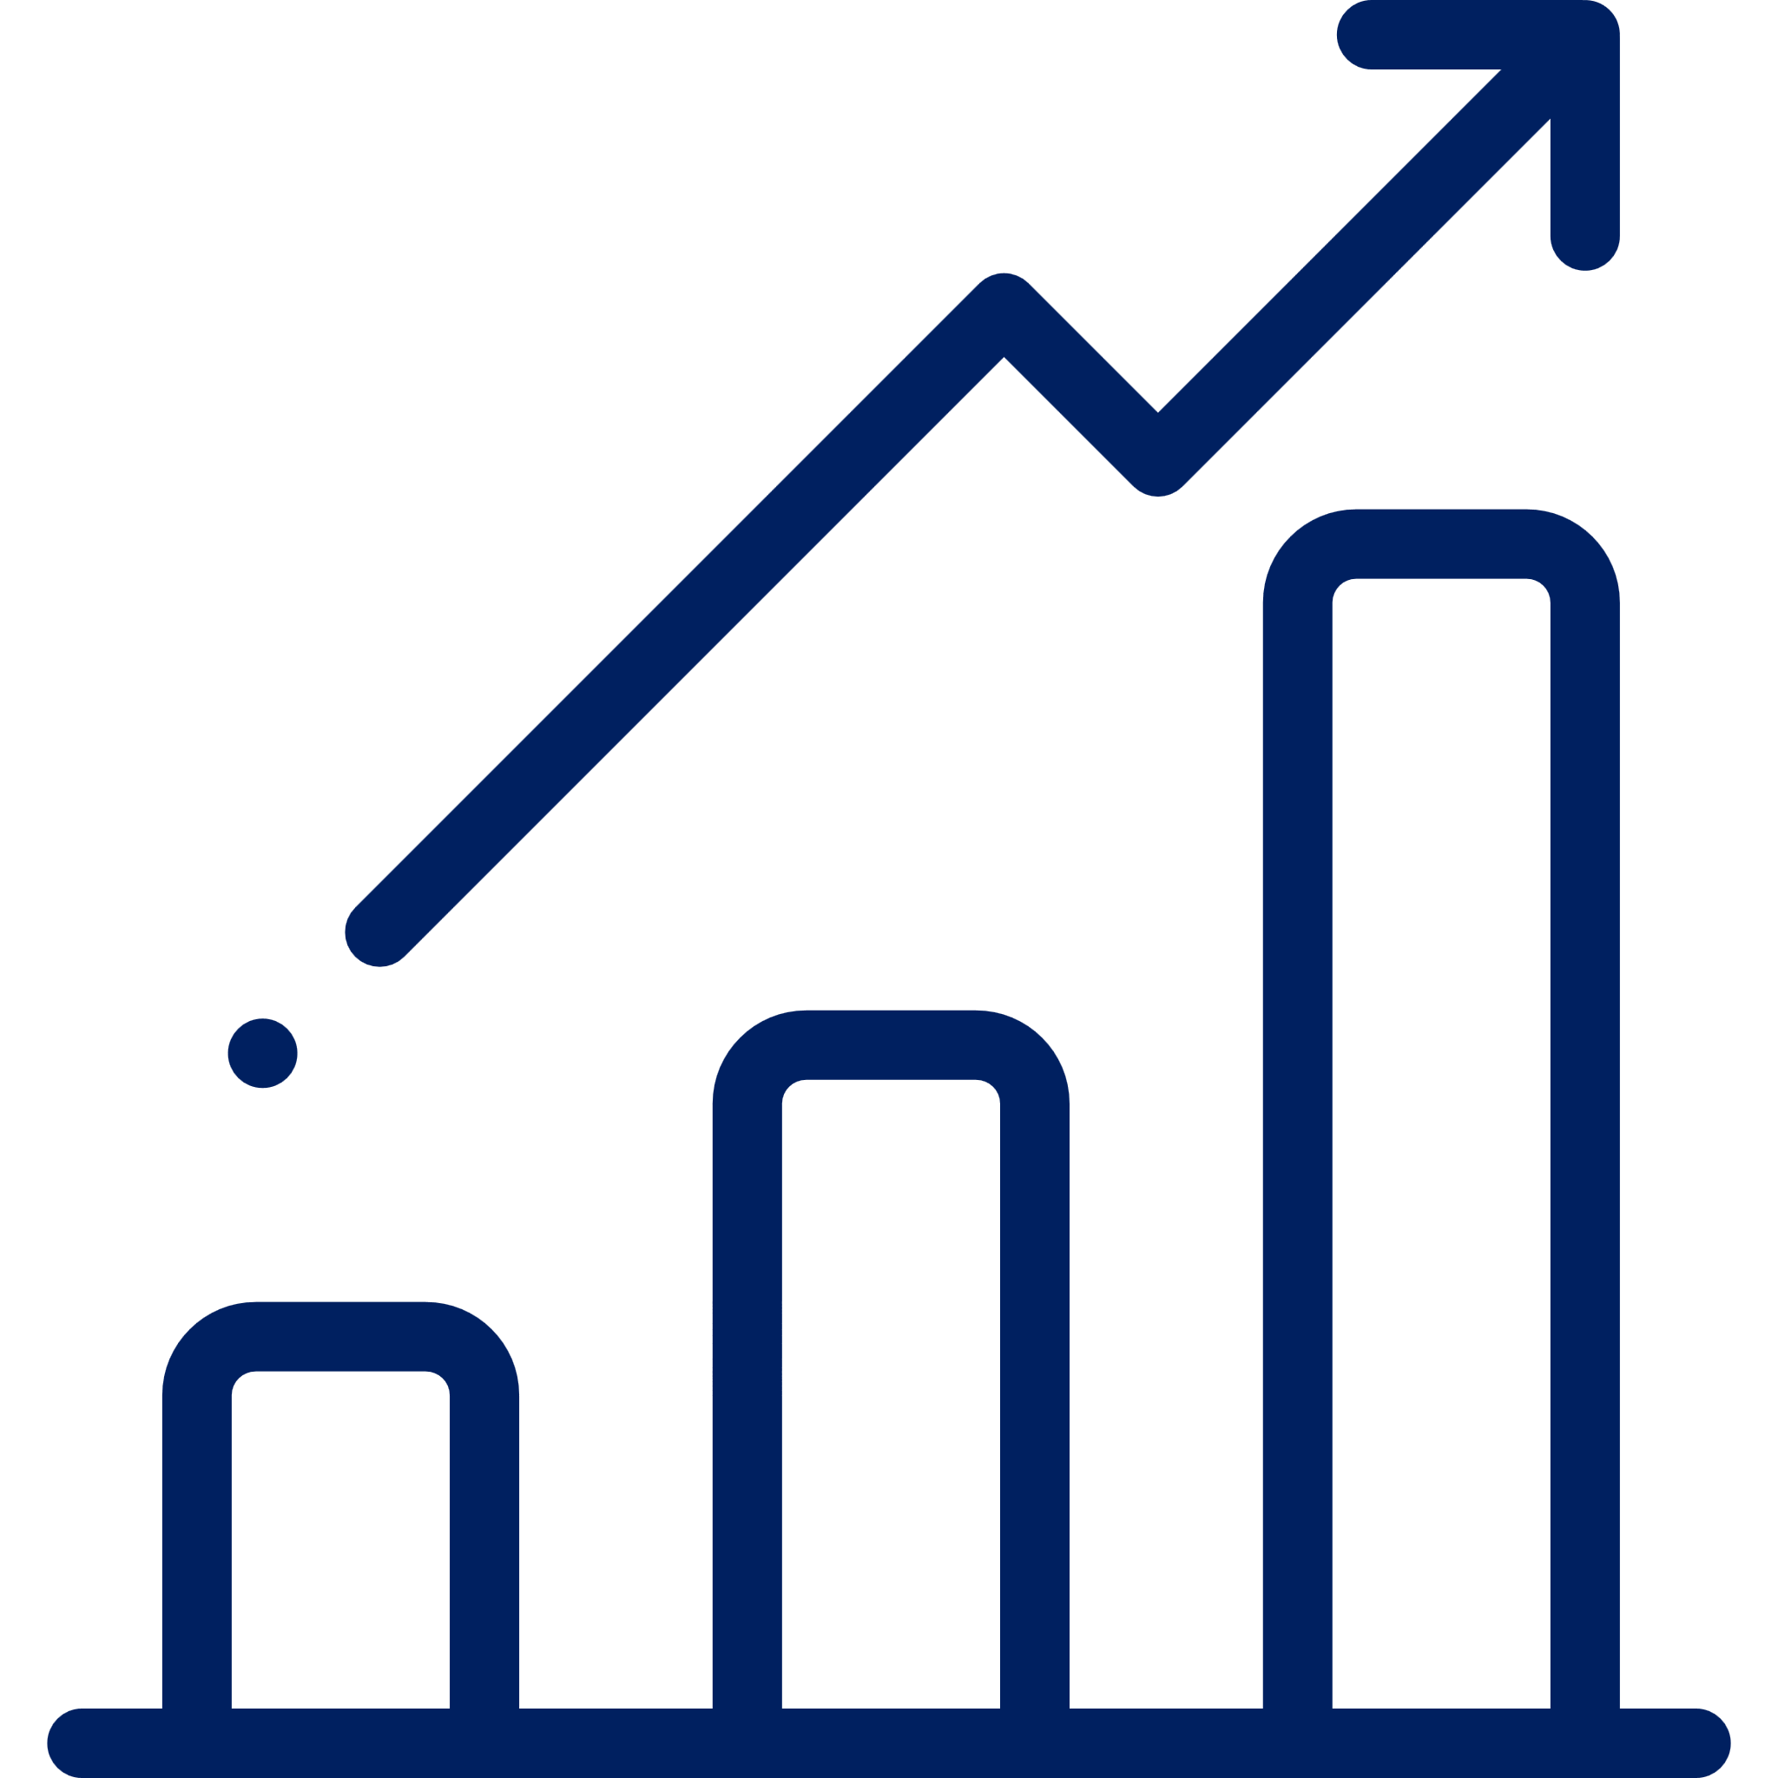






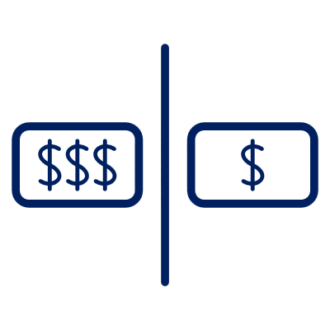

Our Management Consulting Toolkits include 9 key benefits
Improve the growth & efficiency of your organization by leveraging Management Consulting Toolkits created by ex-McKinsey, Deloitte & BCG Consultants.
Make a great investment for your career & organization. It cost us US$8M+ over the past 10 years to create all our Toolkits. Get them for a fraction of this cost.
Get a competitive advantage. It’s like hiring Management Consultants to create all the practical Frameworks, Tools & Templates you need.
Get the job done quicker and never start from scratch again with our ready-made and fully editable Frameworks, Tools & Templates in Powerpoint & Excel.
Don't reinvent the wheel. We have already worked 30,000+ hours over the past 10 years to create all the Management Consulting Toolkits you need.
Improve the capabilities of your organization by learning how the Fortune 100 and Global Consulting Firms do it.
Decrease your costs. Hiring tier-1 Consultants for a project would cost you $300k+. Way more expensive than our Toolkits, which will last you a lifetime!
Become your organization’s subject matter expert and impress your stakeholders with world-class approaches to resolve common business problems.
Get free support and advice from our ex-McKinsey, Deloitte & BCG Management Consultants.

Slide 16
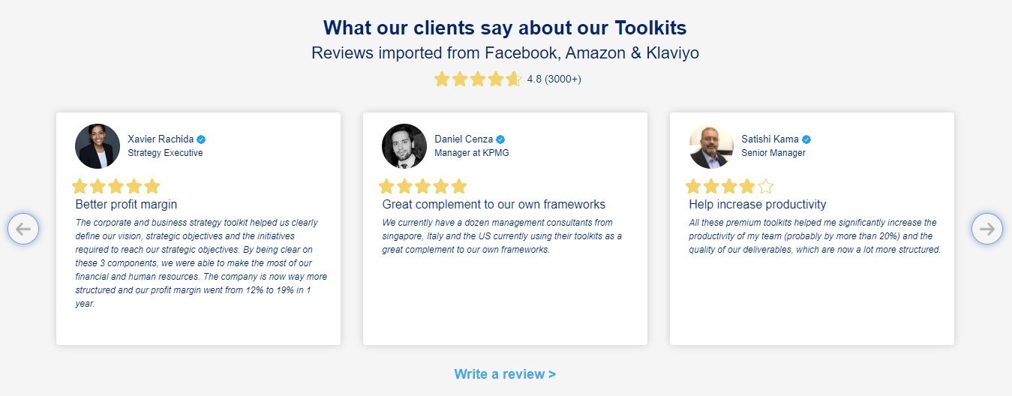
What our clients say about our Toolkits
Click here to see more reviews >

Slide 17

Join 200,000+ Executives, Consultants & Entrepreneurs leveraging our Toolkits to improve the performance of their organization
Trusted by small and large organizations
Customer satisfaction
4.8
Number of countries leveraging our Toolkits
160+
Number of professionals leveraging our Toolkits
200,000+
Daily rate of our ex-McKinsey, Deloitte and BCG Management Consultants
$3k-$4k

Slide 18
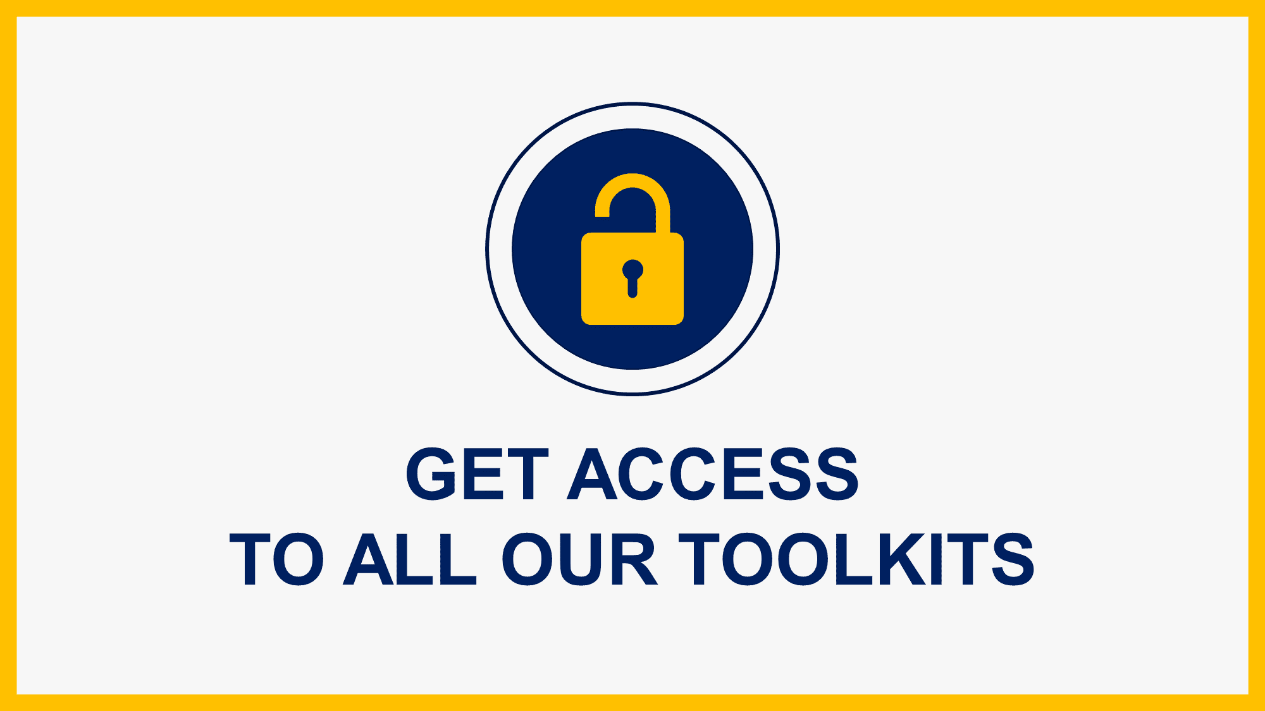
Interested in more than 1 Toolkit? Access all our Toolkits for half the price with our Gold Access
Gold Access
Click here to learn more

Slide 19






Need additional help? Send us a brief and we’ll find you the right talent from our network of 500+ tier-1 Management Consultants
Click here to send us a Project Brief

Slide 20
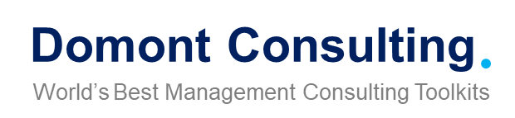
This was just a small preview.
www.domontconsulting.com

